Slide 1
LOGARITHM

Slide 2
WHAT IS LOGARITHM?????
A logarithm is the power to which a number must be raised in order to get some other number.
For example, the base ten logarithm of 100 is 2, because ten raised to the power of two is 100:
log 100 = 2
because
10² = 100
The base unit is the number being raised to a power.
There are logarithms using different base units.

Slide 3
We can also take 2 as the base unit.
For instance, the base two logarithm of eight is three, because two raised to the power of three equals eight:
log₂ 8 = 3
because
2³ = 8

Slide 4
Base Ten Logarithms
Base ten logarithms are expressions in which the number being raised to a power is ten. The base ten log of 1000 is three:
log 1000 = 3
10³ = 1000
A base ten log is written as
log
and in equation form as
log a = r

Slide 5
Natural Logarithms
Logarithms with a base of 'e' are called natural logarithms.
What is 'e'?
'e' is a very special number approximately equal to 2.718. 'e' is a little bit like pi in that it is the result of an equation and it's a big long number that never ends.
A natural logarithm is written
ln
and in equation form as
ln a = r

Slide 6
Relationship between Logarithm and Exponential
Logarithms are the "opposite" of exponentials, just as subtraction is the opposite of addition and division is the opposite of multiplication.
Logs "undo" exponentials or we can say logs are the inverses of exponentials.
antilog
a^{x} = m …………is equivalent to……….. log_{a} m = x
log

Slide 7
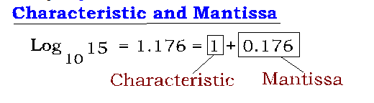
Characteristic and Mantissa
CHARACTERISTIC
It is the integral part of the value
MANTISSA
It is the decimal part of the value

Slide 8
Laws of Logarithms
Product rule - multiplication becomes addition
Quotient rule - division becomes subtraction
Power rule - exponent becomes multiplier

Slide 9
Laws of Logarithms
Change of Base Formula
If base is not mentioned, then base will be 10.

Slide 10
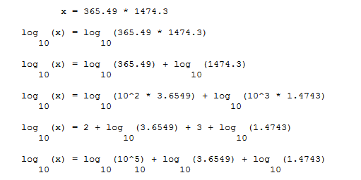
In mathematics logarithms were developed for making complicated calculations simple.

Slide 11
Q: The value of log(.01)(1000) is:

Slide 12
Q: The logarithm of 0.0625 to the base 2 is:

Slide 13
Q: If log ₈ X= 2/3, then the value of x is :

Slide 14
Q: If log_{x} y = 100 and log₂ x = 10, then the value of y is :

Slide 15
Q: The value of log ₂ (log₅ 625) is:

Slide 16
Q: If log ₂ [log₃ (log ₂ X) ] =1, then x is equal to:

Slide 17
Q: If log₁₀ 125 + log₁₀ 8 = x, then x is equal to :

Slide 18
Q: (log₅ 3) x (log₃ 625) equals :

Slide 19
Q: If log₁₂ 27 = a, then log₆ 16 is :

Slide 20
Q: The value of (log₃ 4) (log₄ 5) (log₅ 6) (log₆ 7) (log₇ 8) (log₈ 9) is:

Slide 21
Q: If log₁₀ 2=0.3010, what is the number of digits in

